Slide 1

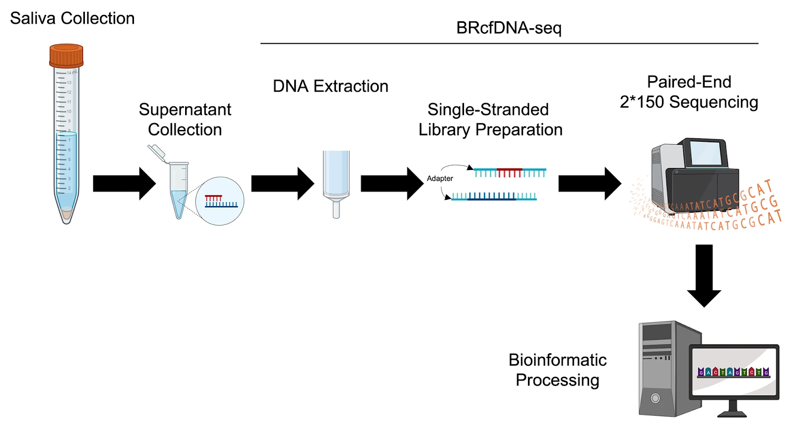
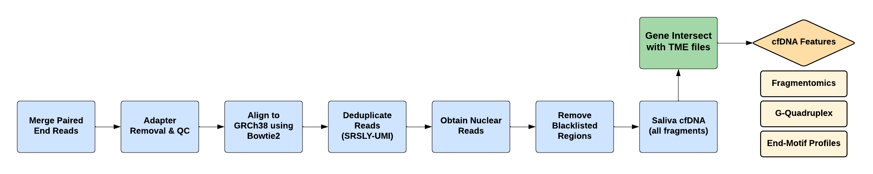
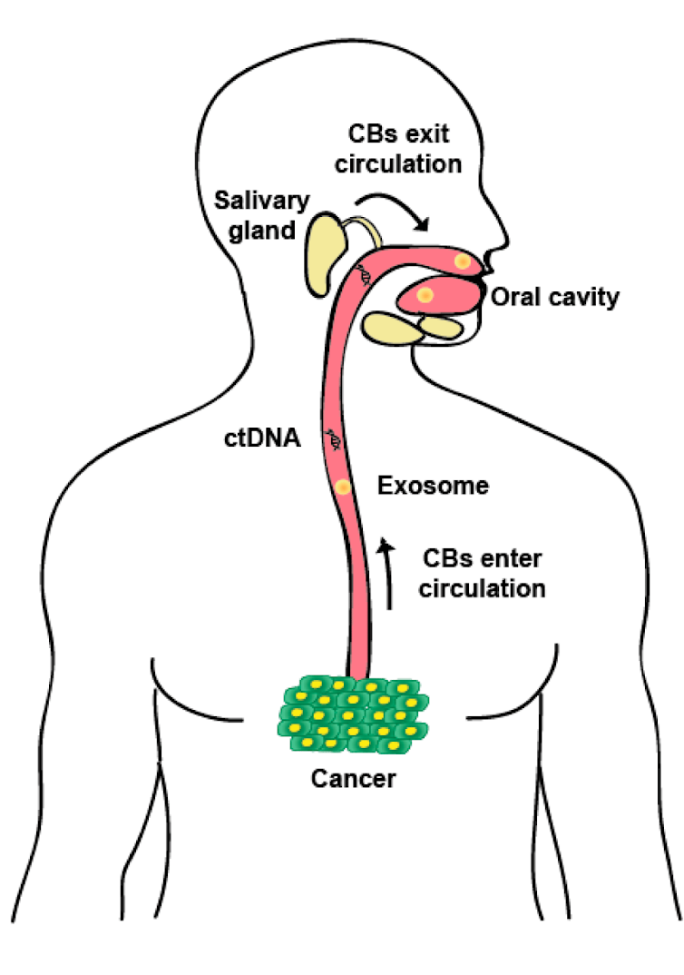
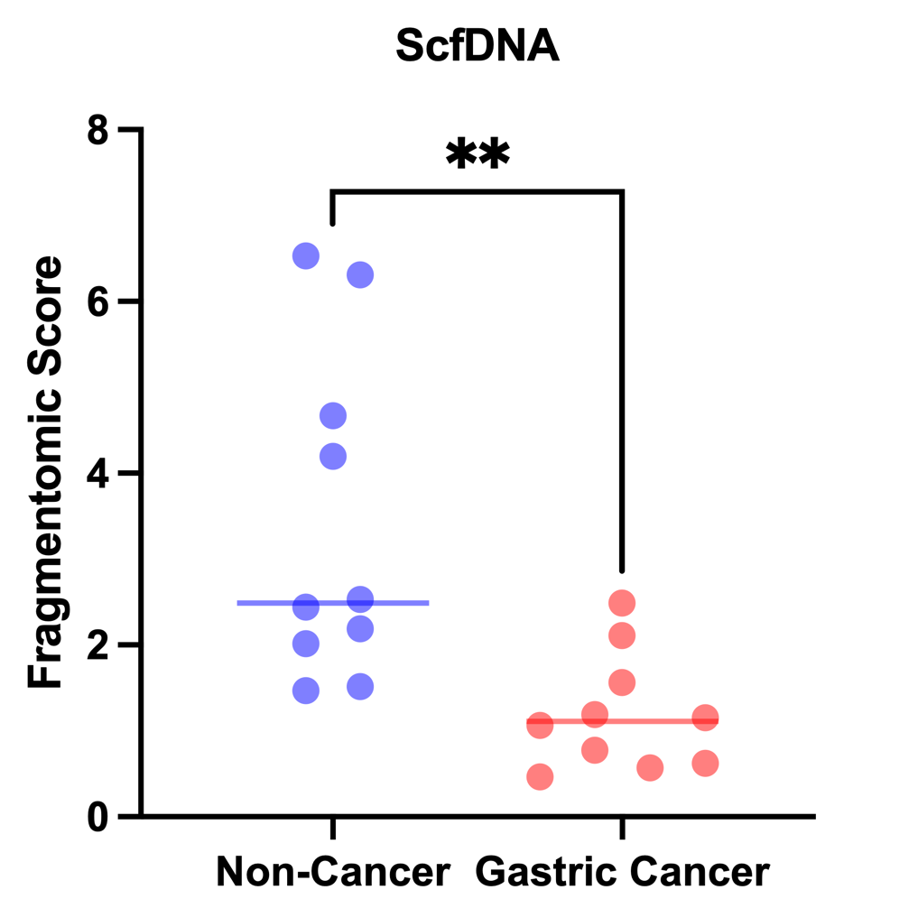
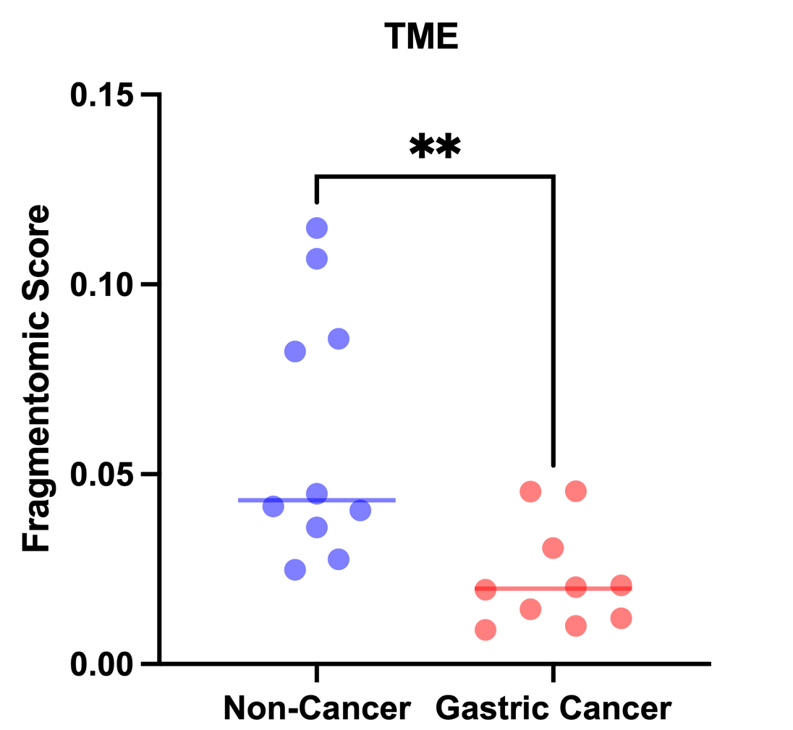
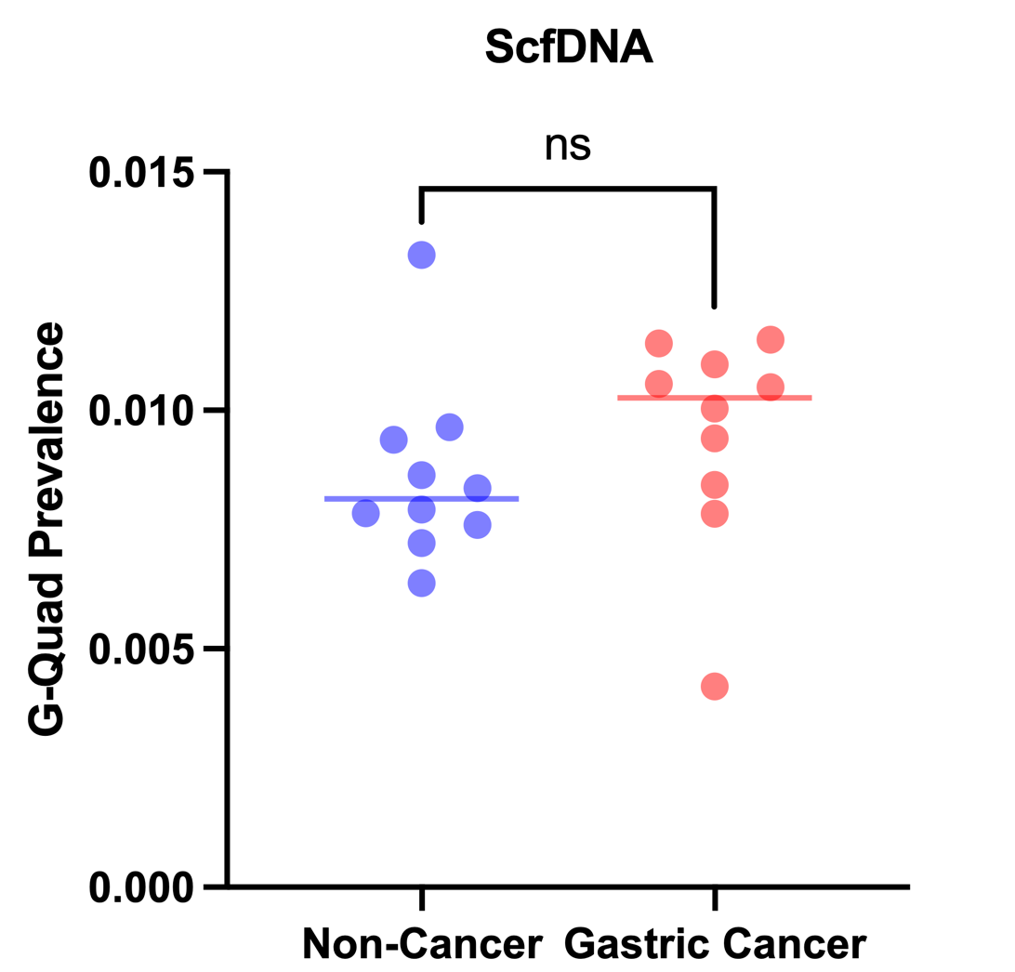
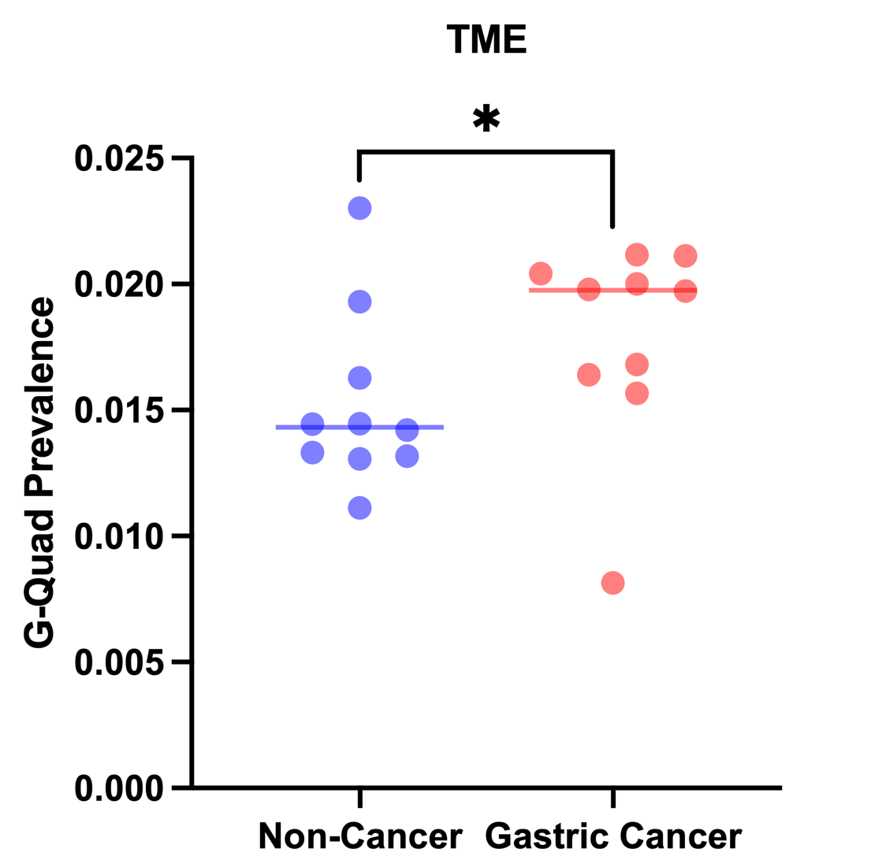
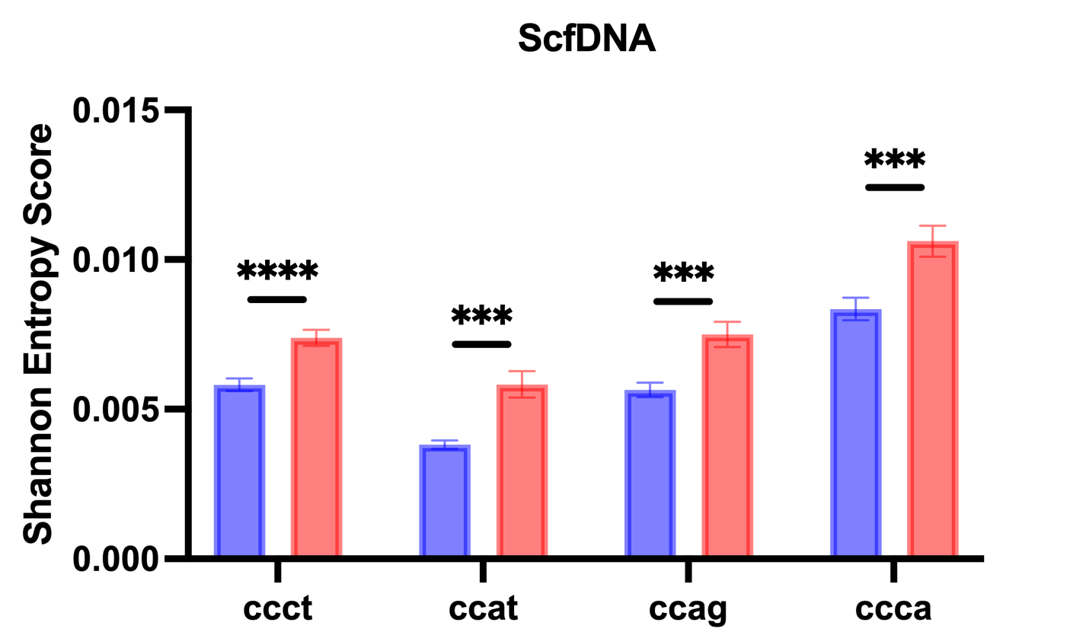
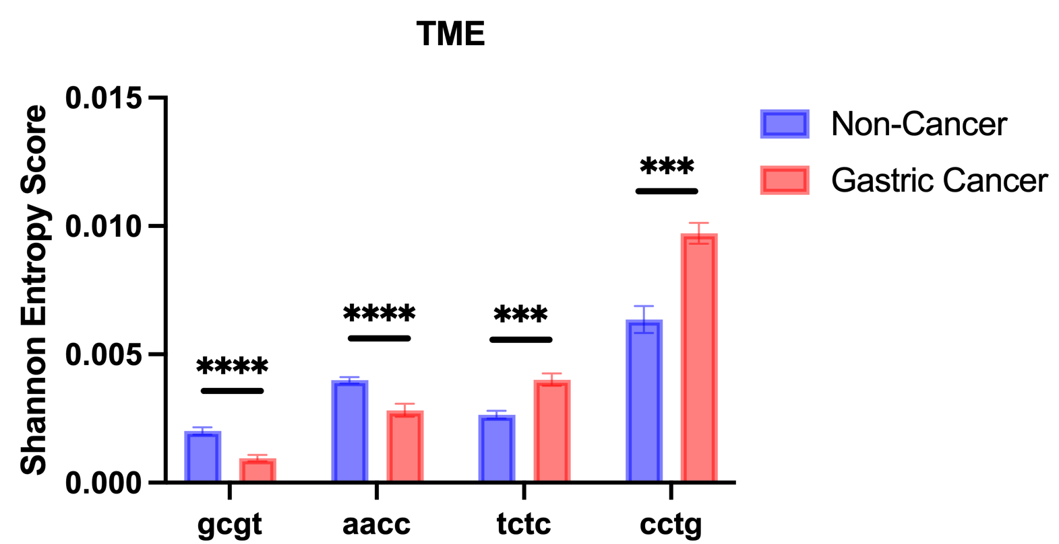


Saliva Cell-Free DNA as a Biomarker for Early Detection of Gastric Cancer
LOUISE OH¹, HASSOON SARWAR¹, Aaron Zander¹, Dev Trivedi¹, Irene Choi², Neeti Swarup², Mohammed Aziz², David Wong²
¹BIG Summer Program, Institute for Quantitative and Computational Biosciences, UCLA,
²School of Dentistry, UCLA
Abstract
Methodology
Gastric cancer (GC) is one of the leading causes of cancer death annually and due to its disease heterogeneity, it is difficult to detect during early stages. The tumor microenvironment (TME) includes various molecular components, such as immune cells, that favor tumor progression. Previous studies have utilized salivary cell-free DNA (cfDNA) as a non-invasive means to guide early cancer detection. This project explores non-mutational analyses of cfDNA and considers the TME of GC to investigate the underlying genetic differences between non-cancer and gastric cancer patients. We employed a low-coverage single-stranded library NGS pipeline on saliva samples of the two cohorts to study cfDNA characteristics including fragmentomics, G-quadruplex prevalence, and end-motif profiles. Our analysis showed a significant difference between the two cohorts for both saliva cfDNA characteristics and TME-specific biomarkers. These discoveries could potentially improve the application of cfDNA analysis in clinical settings for both early disease detection and monitoring its progression.
A.
Figure 3. A) BRcfDNA-seq laboratory workflow. B) Overarching bioinformatic processing for cfDNA.
B.
Results
Conclusions
Through the implementation of a novel cfDNA processing pipeline (BRcfDNA-Seq), distinct features between cancer and non-cancer samples were observed. We examined the tumor microenvironment to understand how cfDNA influences the tumor landscape, as TME interactions are crucial for cancer progression.
Fragmentomic Score (ratio of short-to-long fragments) was lower for cancer samples across all chromosomal bins revealing a greater proportion of longer cfDNA fragments in the cancer cohort.⁵ This quantitative metric could serve as a viable biomarker for cancer detection in clinical settings. Differentiation between cohorts through TME-specific biomarkers indicates that cancer proliferating molecules can be classified through fragment length analysis.
G-Quadruplex secondary structures (G4s) are associated with genomic instability and oncogenic processes.⁶ TME-specific analysis revealed a higher retention of G4s in cancer samples while ScfDNA analysis showed no significant difference.
End-Motif Profiles are related to cellular activities of nuclease enzymes and represent distinct fragmentation signatures, such as DNAse1L3 which is known to produce Cytosine-rich end motif sequences.^{2,7} ScfDNA analysis revealed that certain C-rich motifs (CCCT, CCAT, CCAG, and CCCA) were significantly different between the two cohorts. TME-specific analysis revealed a new set of unique 4-mer end motifs that were also C-rich.
These findings reveal that TME-specific analysis can guide a more intricate differentiation between non-cancer and cancer samples with potential clinical utility for existing and new molecularly targeted and immune therapies.⁸
Background
Cell-free DNA (cfDNA) analysis has recently emerged as a promising tool for non-invasive and early disease detection.¹ Compared to other biofluids, saliva is easily accessible and validated to contain specific cfDNA signatures that differentiate cancer and healthy patients. However, the heterogeneity of systemic diseases, such as gastric cancer (GC), presents a unique challenge in early detection because multiple cellular components are involved in disease onset and progression.² Previous research has demonstrated that circulating-tumor DNA (ctDNA) is detectable in saliva samples, but a lack of established tumor-specific genetic alterations hinder accurate detection.
Figure 4. ScfDNA fragment score for every chromosomal bin for autosomal chromosomes in cancer and noncancer groups, solid line representing mean, dashed line representing SEM.
Fragmentomics
G-Quadruplex Prevalence
A.
B.
A.
B.
Figure 5. Fragment score between the cancer and noncancer groups using Student’s t test. A) Saliva cell-free DNA. P-value = 0.0015. B) Tumor microenvironment. P-value = 0.0052
Figure 6. G-Quadruplex prevalence between the cancer and noncancer groups using Student’s t test. A) Saliva cell-free DNA. P-value = 0.1230. B) Tumor microenvironment. P-value = 0.0433.
Figure 1. Pathway of circulating biomarkers (CBs) from cancer cells to oral cavity.³
Figure 2. Distribution of ScfDNA fragment length for gastric cancer (n = 10) and non-cancer (n = 10) cohorts.
End-Motif Profiles
References
A.
B.
To address these limitations, we employed a novel, single-stranded technique termed Broad Range Cell-Free DNA Sequencing (BRcfDNA-Seq) that utilizes non-mutational analysis of salivary cfDNA (ScfDNA) characteristics such as fragment length, end motifs, and G-quadruplex prevalence.² Since GC is a heterogeneous disease, considering the tumor microenvironment (TME), which includes cancer associated fibroblasts, immune, and endothelial cells, can reveal important information about the molecular landscape.⁴ Identifying and establishing TME-specific biomarkers can help uncover the genetic processes and cellular interactions that contribute to cancer proliferation.
¹PMC6425120, ²PMC10371094, ³PMC6082266, ⁴PMC7419059, ⁵PMC6774252, ⁶PMC7905668, ⁷PMC10151549, ⁸PMC10418549
Additional Resources
Figure 7. 4-mer end motifs with the most significant difference between cancer and noncancer groups, with each bar representing the mean with SEM. Discoveries at Desired FDR Q at 2.5%, P-values from Mann-Whitney Tests (*** p < 0.001, **** p < 0.0001). A) Saliva cell-free DNA. B) Tumor microenvironment.
W Lab @ UCLA
BRcfDNA-Seq GitHub

